Slide 1
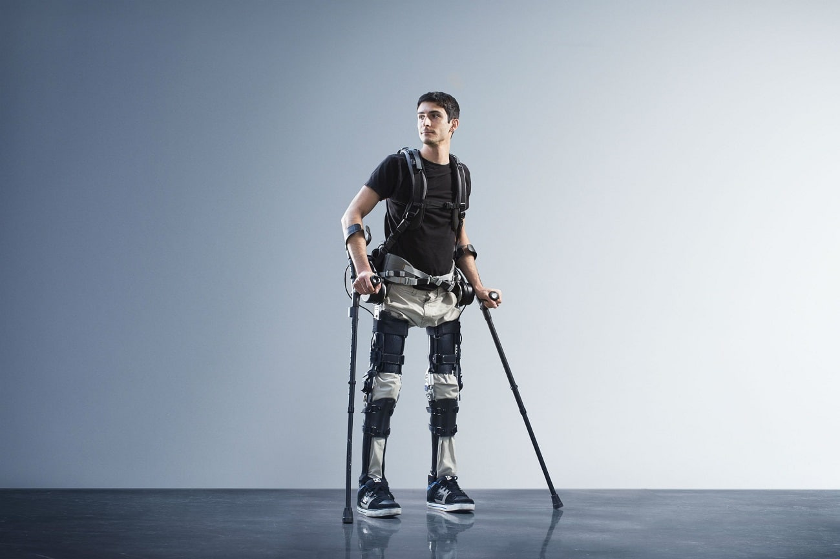



fdgf
Applying Neural Network to the Exoskeleton Robots to Improve Movement Flexibility
By Ali Ahmadi
Supervisors:
Prof. Olivier Bruneau
Prof. Federica Battisti
Prof. Miguel Colom
Prof. Bastien Berret
Lucas Quesada
Paris Saclay-Spring 2024

Slide 2
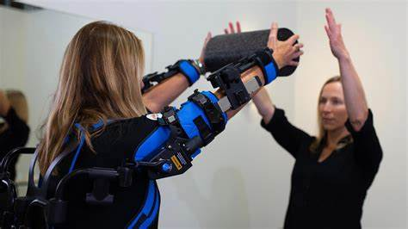
Background : Exoskeleton Robots
Wearable devices designed to assist or enhance human movement.
Commonly used in medical rehabilitation and industrial applications.
Mimic natural human limb movements for added strength and stability.
Help reduce worker fatigue and aid in patient mobility recovery.

Slide 3
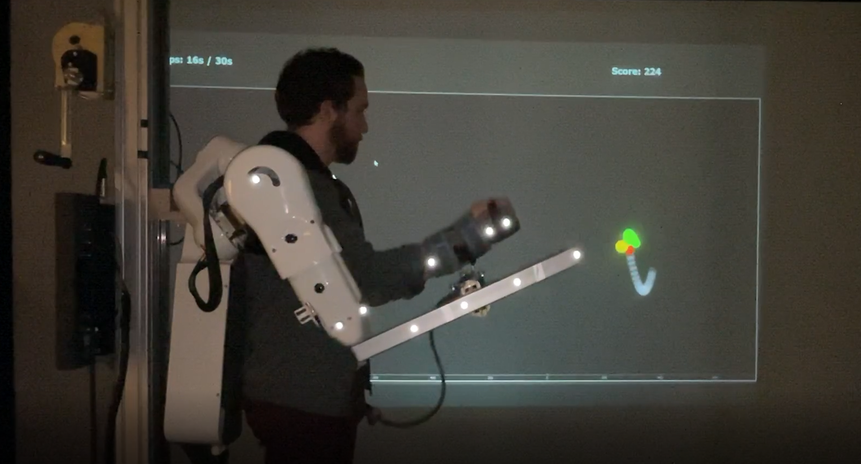

Slide 4
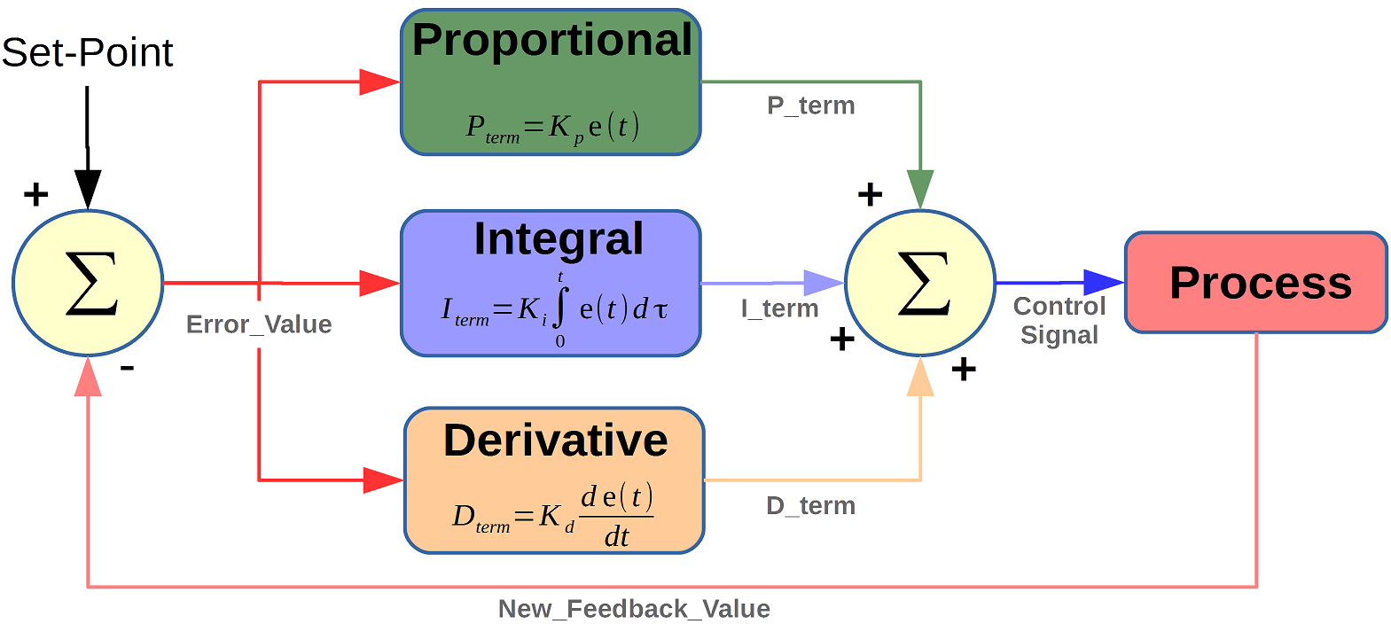
Background: Existing Control Methods
Traditional methods: PID control, impedance control.
Often result in rigid, unnatural movements.
Lack adaptability to changing environments or dynamic tasks.
Limitations in user comfort and effectiveness during use.
Derivative: prevent overshooting
Integral: increase the correction

Slide 5
Problem Statement
Existing exoskeleton systems struggle with smooth, flexible movements.
Current control methods do not adapt well to varying tasks. PID
Prediction of the human movement is hard due to the Absence of real time prediction
of brain decision .
Weakness in Adapting to the different users

Slide 6
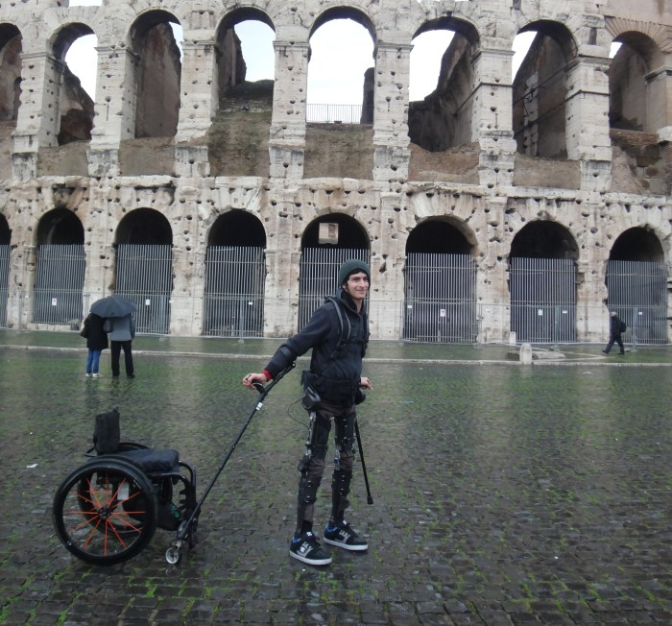
Project Goals
Improve exoskeleton movement flexibility using Reinforcement Learning and
Achieve smoother, more natural user interactions.
Using reinforcement learning because the interaction is in real time between
Exoskeleton and User and needs to finetuning base on interaction
Of each user with Exoskeleton
Build virtual environment to train our reinforcement learning first there due to the:
1.It could be dangerous to train the model first on human due to the possible overshooting
2.it takes long time and lots of iteration for training more than a Million iteration
Training and testing model in virtual environments and then testing on the real
Exoskeleton robots and Finetuning based on different humans

Slide 7
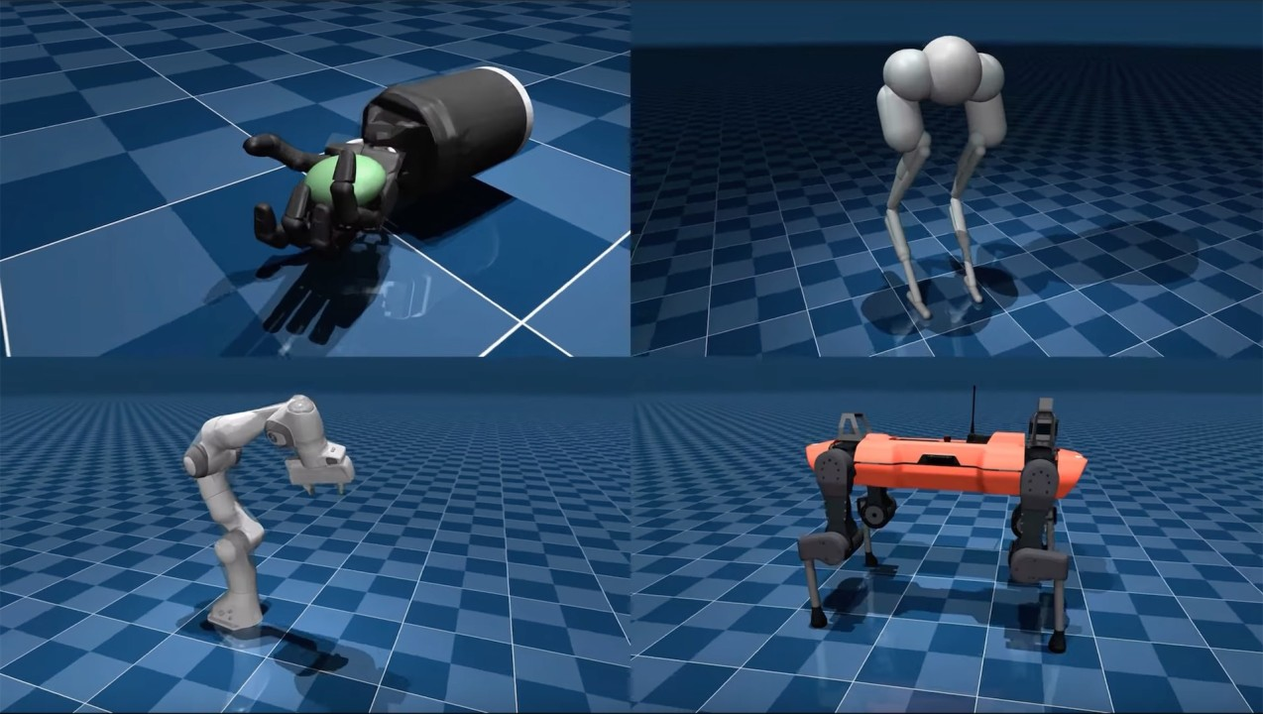
Existing Simulation Environment
Utilize tools like Gazebo and MuJoCo for simulation.
Works base on Physical formulas of the environment but not as good as simulation
From real dataset of the Exoskeleton
Takes long time for simulating due to the graphic engine base methods
Hard to modify the environment because they are not based on the data of the Model

Slide 8
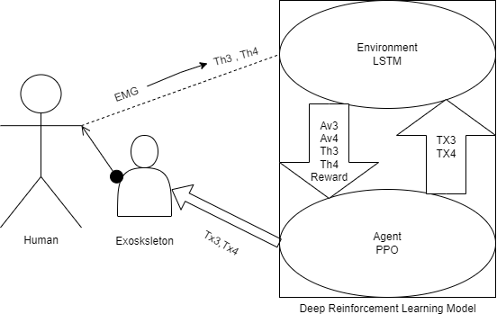
Proposed Method Infographic

Slide 9
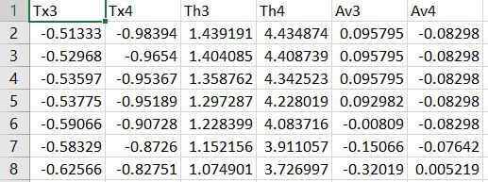
Data Preparation
Collected and cleaned relevant data for training models.
We used Torque of Human and Torque of Exoskeleton as a input and Angular velocity
As an output
Concatenating of 6 different data from previous experiment with Exoskeleton
Ensured data is representative of real-world scenarios.

Slide 10
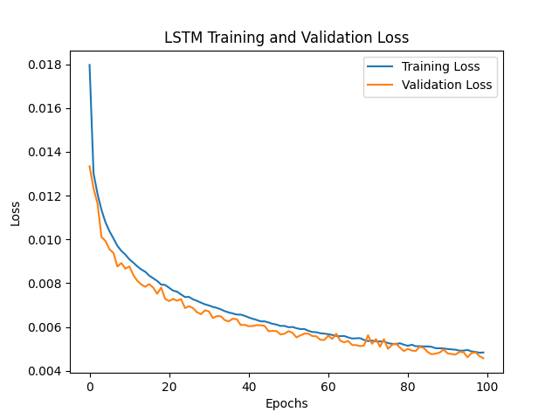
Training the Simulator Models
Trained models using Deep learning techniques such as a CNN
Optimized through large hyperparameter tuning and some more advance
techniques like Regularization technics such as drop out.
Using Random Forest , SVR (support vector regression , XGBoost)
Using Deep learning models such as CNN
Using Recurrent Neural Network for better result such as LSTM

Slide 11
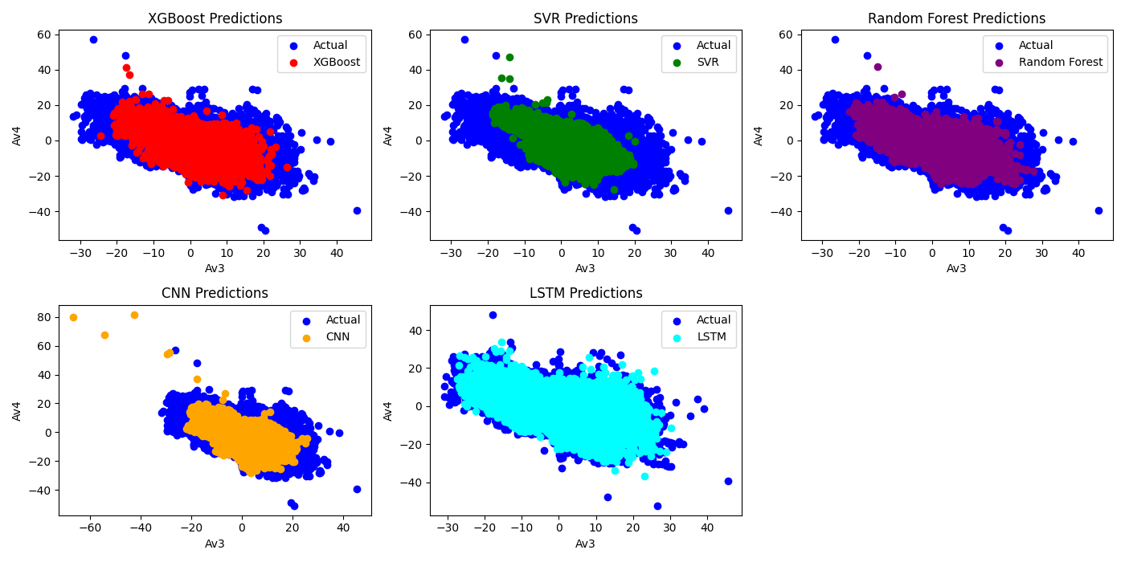
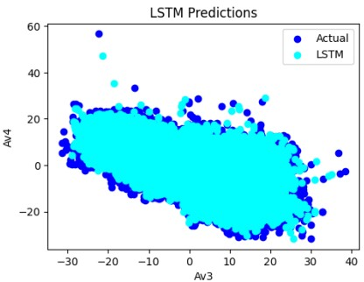
Learning Models Results graph

Slide 12
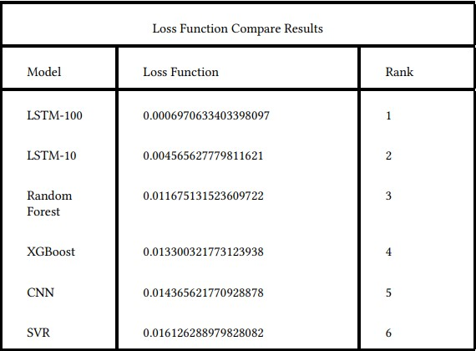
Loss function of models comparison

Slide 13
Flash-back

Slide 14
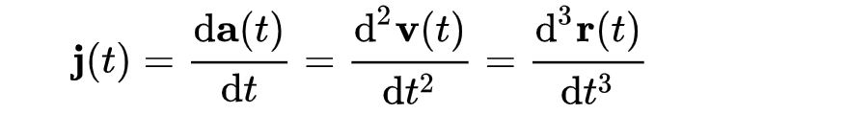
Reward Function and Self State
JERK : the quantity of acceleration variation, is a kinematic
parameter used to assess the smoothness of movement.
3rd Derivative of Position or second derivative of Velocity
Self state contacting Torque that should be applied to the Exoskeleton
(Current of the Motors) based on the
Human Torques that are coming from EMG sensors Calculate by PID
Agent try to find best current around the self state that can maximize the
Reward function or Minimize jerk for more flexible movement

Slide 15
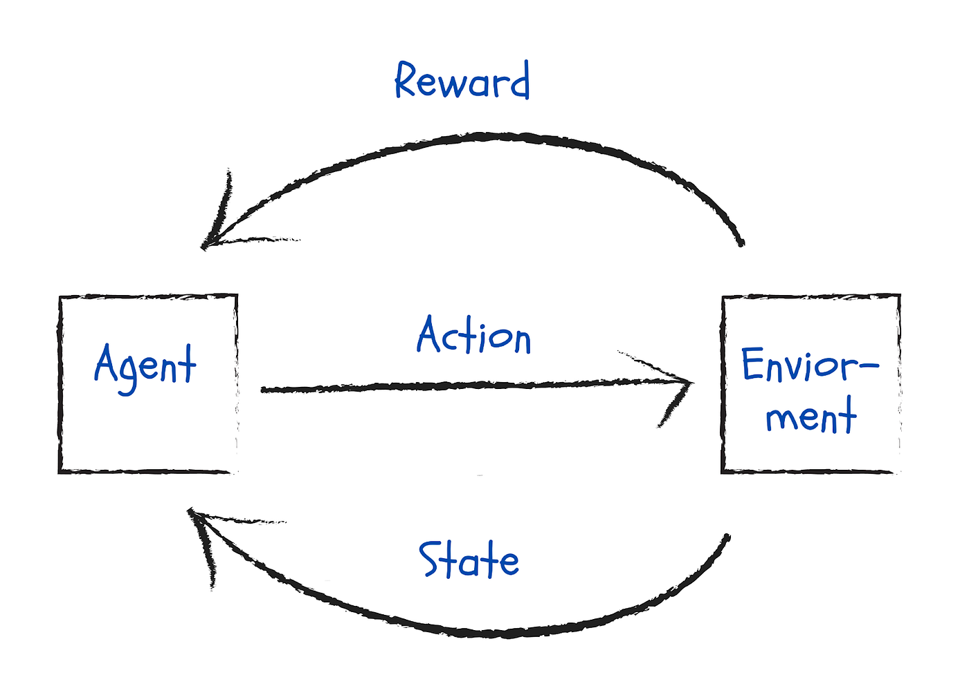
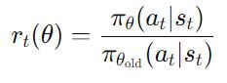
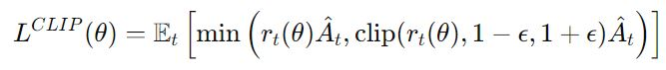
Reinforcement Learning Agent PPO (Proximal Policy Optimization)
Designed and implemented a reinforcement learning agent.
Focused on optimizing control for movement flexibility.
Why PPO?
1.Smooth Policy Updates and Controlled Exploration
2. Robustness to Noise
4. Continuous Action Spaces
5. Less Sensitivity to Hyperparameters
6. Successful Applications in Robotics

Slide 16
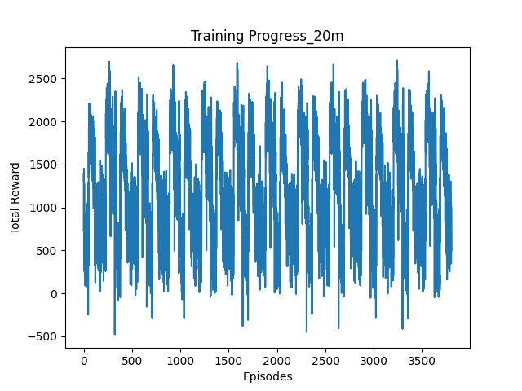
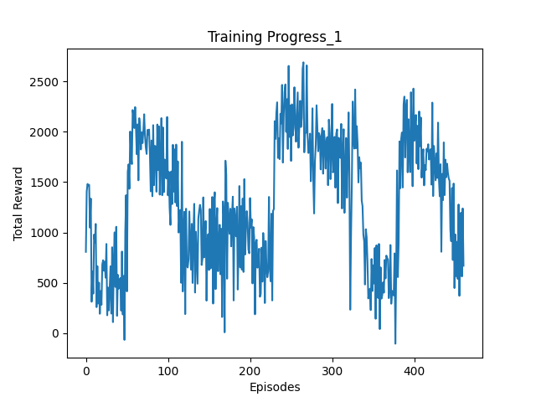
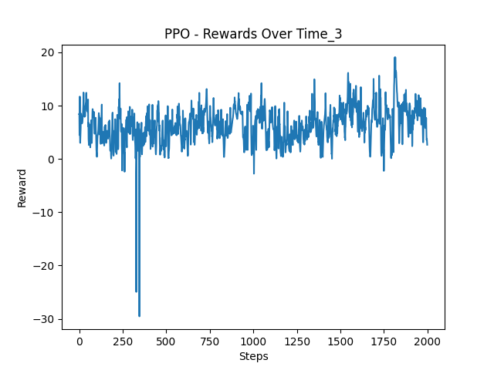
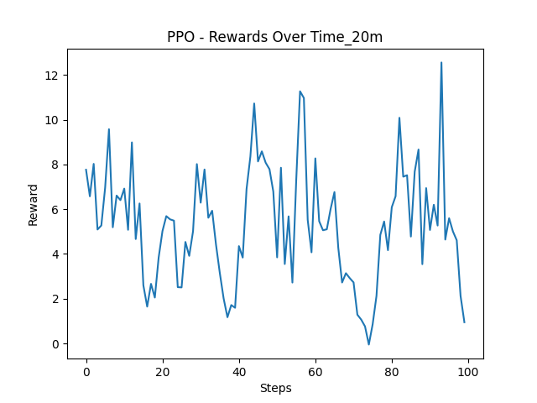
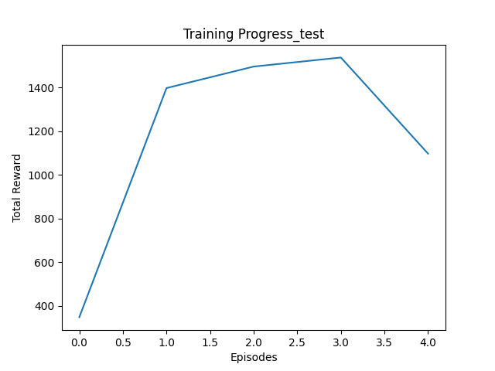
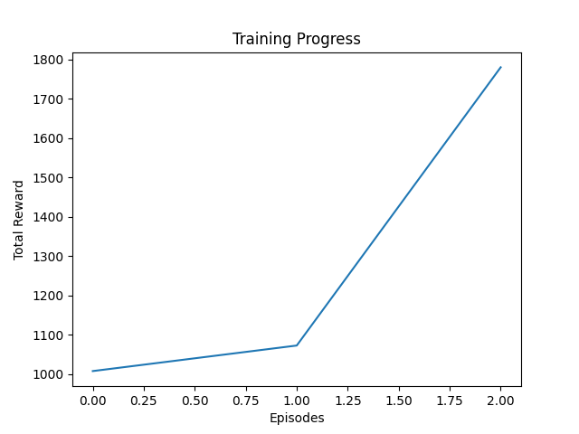
Reinforcement Learning Results

Slide 17
Result interpretation
Positive Reward function means that Overall activity of Agent is good and can predict very good
Although Positive Result they are some sharp fluctuation
We assume that the fluctuations because of concatenation of different experiments can lead to some sharp change in the Human Torque
Also the Environment is so complex [(13200) power 10] and LSTM model predictions are expensive function converging is hard so:
1. it needs to train for longer time (for 1 million iteration it takes almost 17 hours)
2.Reiforcement Learning normally are so hard to stabilize and so sensitive to hyperparameters and reward function due to interaction and not having offline dataset so hyperparameter tunning takes time and needs trial and errors
3.we are in the simulation mode which is different from real world and due to our not perfect dataset we have fluctuations

Slide 18
Conclusions and Future Works
Due to our Positive result we plan to spend more time to stabilize the agent to get better result in the future
After getting much better result , we plan to test our model on Exoskeleton to finetune our model base on real world application
We will try to make our dataset better for future testing
We will try to test more Deep Reinforcement Learning Agents for better Comparison the results and achieve better outputs
We hope we can have better devices like GPU for faster training and more tiral and error to find perfect parameters for stabilizing the Reinforcement learning agent

Slide 19
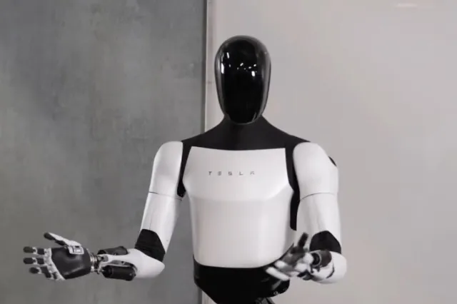
Thank you !

